Slide 1
HR MANAGEMENT SYSTEM

Slide 2
CONTENT
The HR Management System (HRMS) is designed to automate core HR functions such as managing employee data, tracking attendance, and handling payroll.
The goal is to improve operational efficiency and ensure accuracy in data management

Slide 3
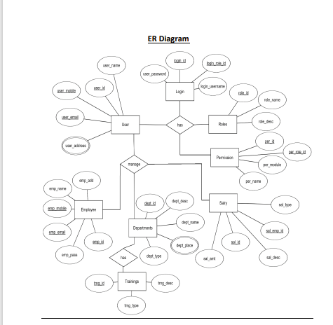
Prototype

Slide 4
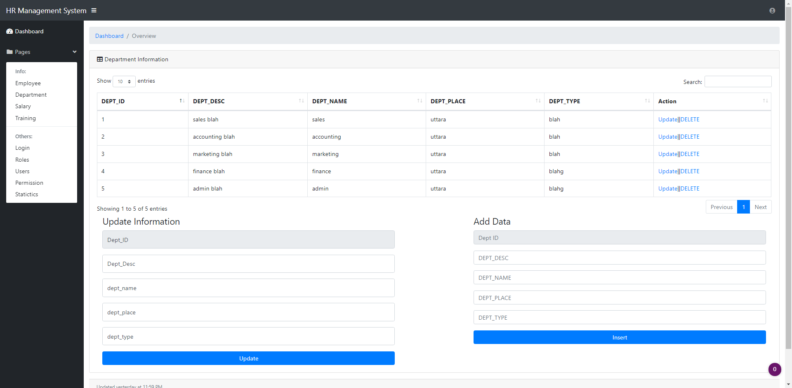

Slide 5
Title: Potential Benefits Efficiency: Reduces time spent on manual HR tasks. Accuracy: Ensures accurate record-keeping and payroll calculations. Employee Satisfaction: Increases transparency and trust in HR processes. Scalability: Easily adaptable for organizations of different sizes.

Slide 6
Links
https://github.com/Prachikumari2/HR-Management-system.git

